Slide 1
A Magnetically Controlled Guidewire Robot System
By JunAng Wang
2023/11/01

Slide 2
Outline
Project Overview
Deformable Object Simulation
Dynamics and Mechanics of a Rod (Cosserat Rod Theory)
Outlook

Slide 3
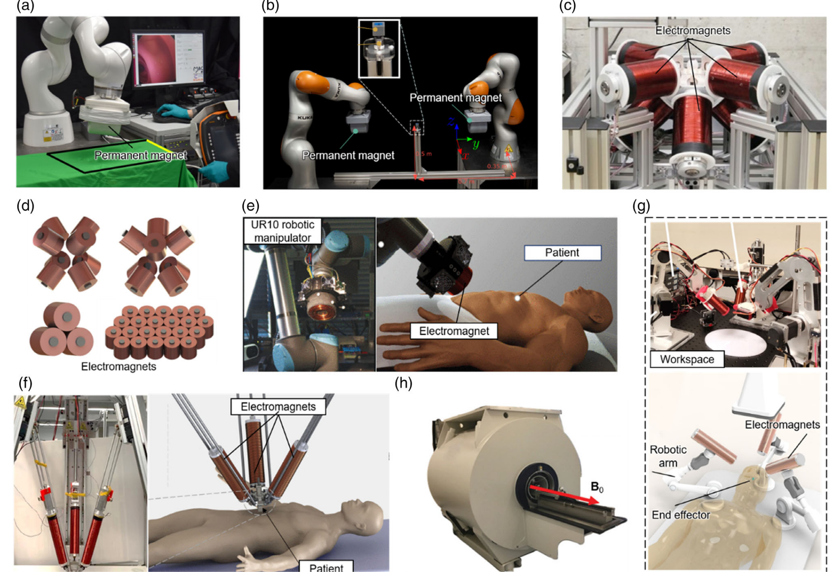
What we are studying at?
Yang, Z., Yang, H., Cao, Y., Cui, Y., & Zhang, L. (2023).

Slide 4
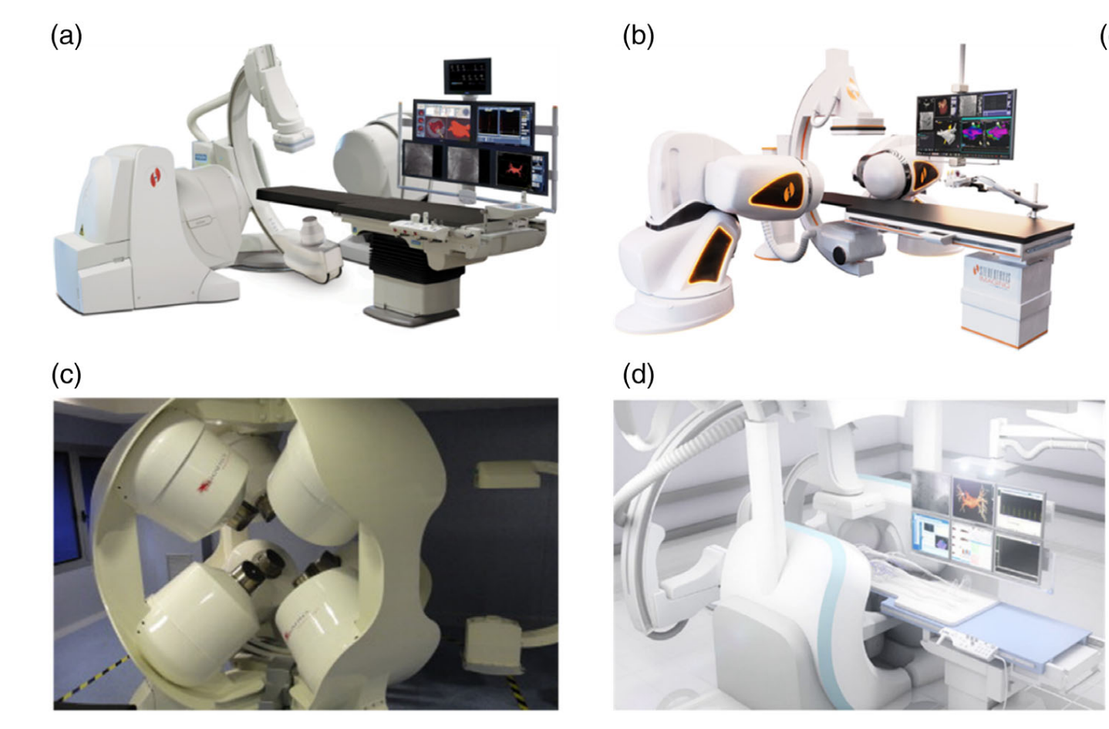
What we are studying at?
Yang, Z., Yang, H., Cao, Y., Cui, Y., & Zhang, L. (2023).

Slide 5
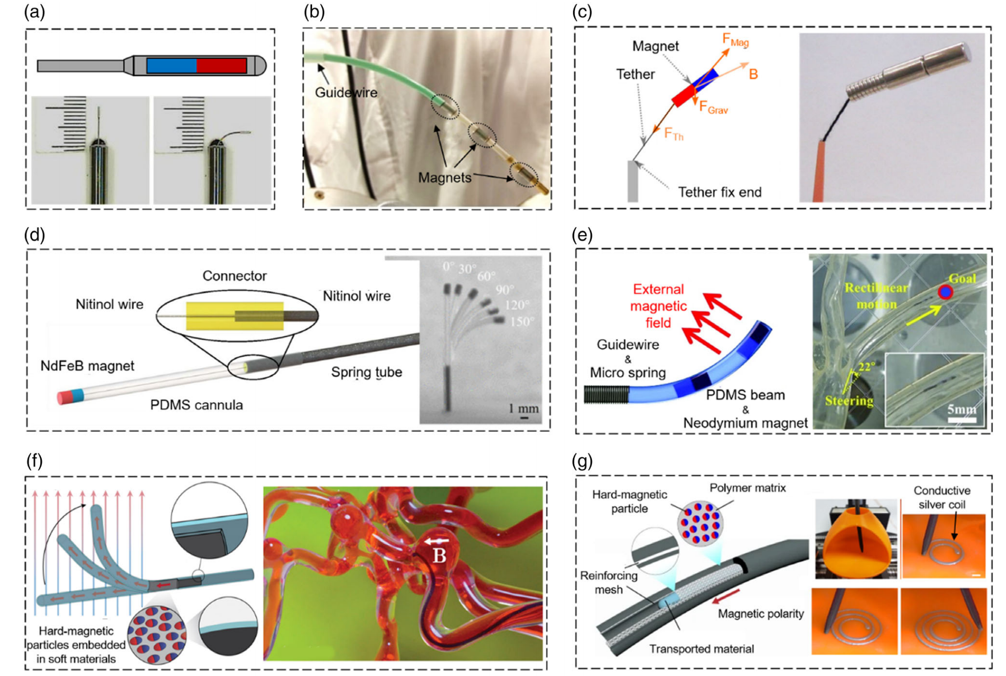
What we are studying at?
Yang, Z., Yang, H., Cao, Y., Cui, Y., & Zhang, L. (2023).

Slide 6
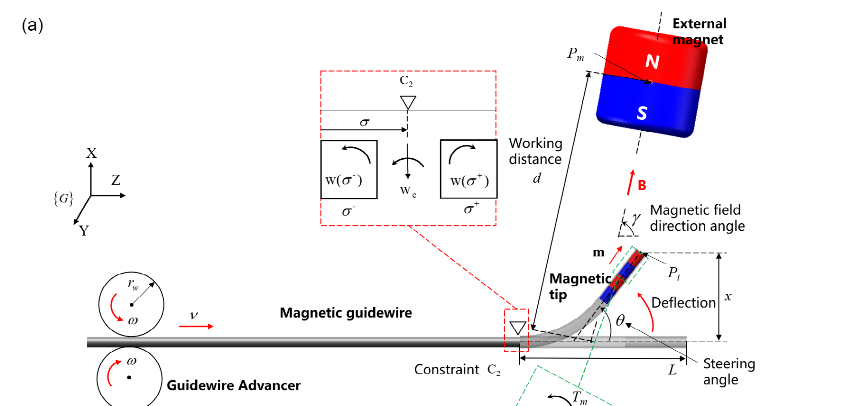
What we are studying at?
Fu, S., Xu, T. et al. 2023

Slide 7
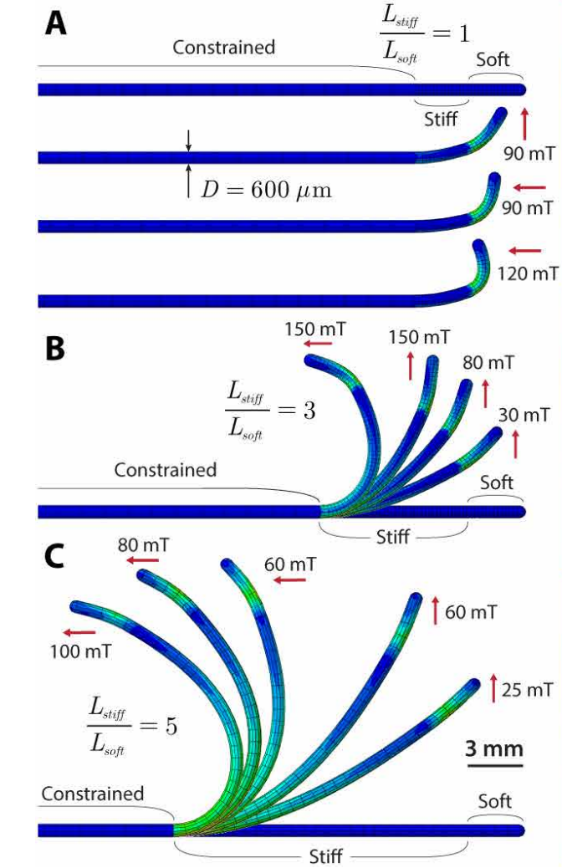
What we are studying at?
Yoonho Kimet al. 2019

Slide 8
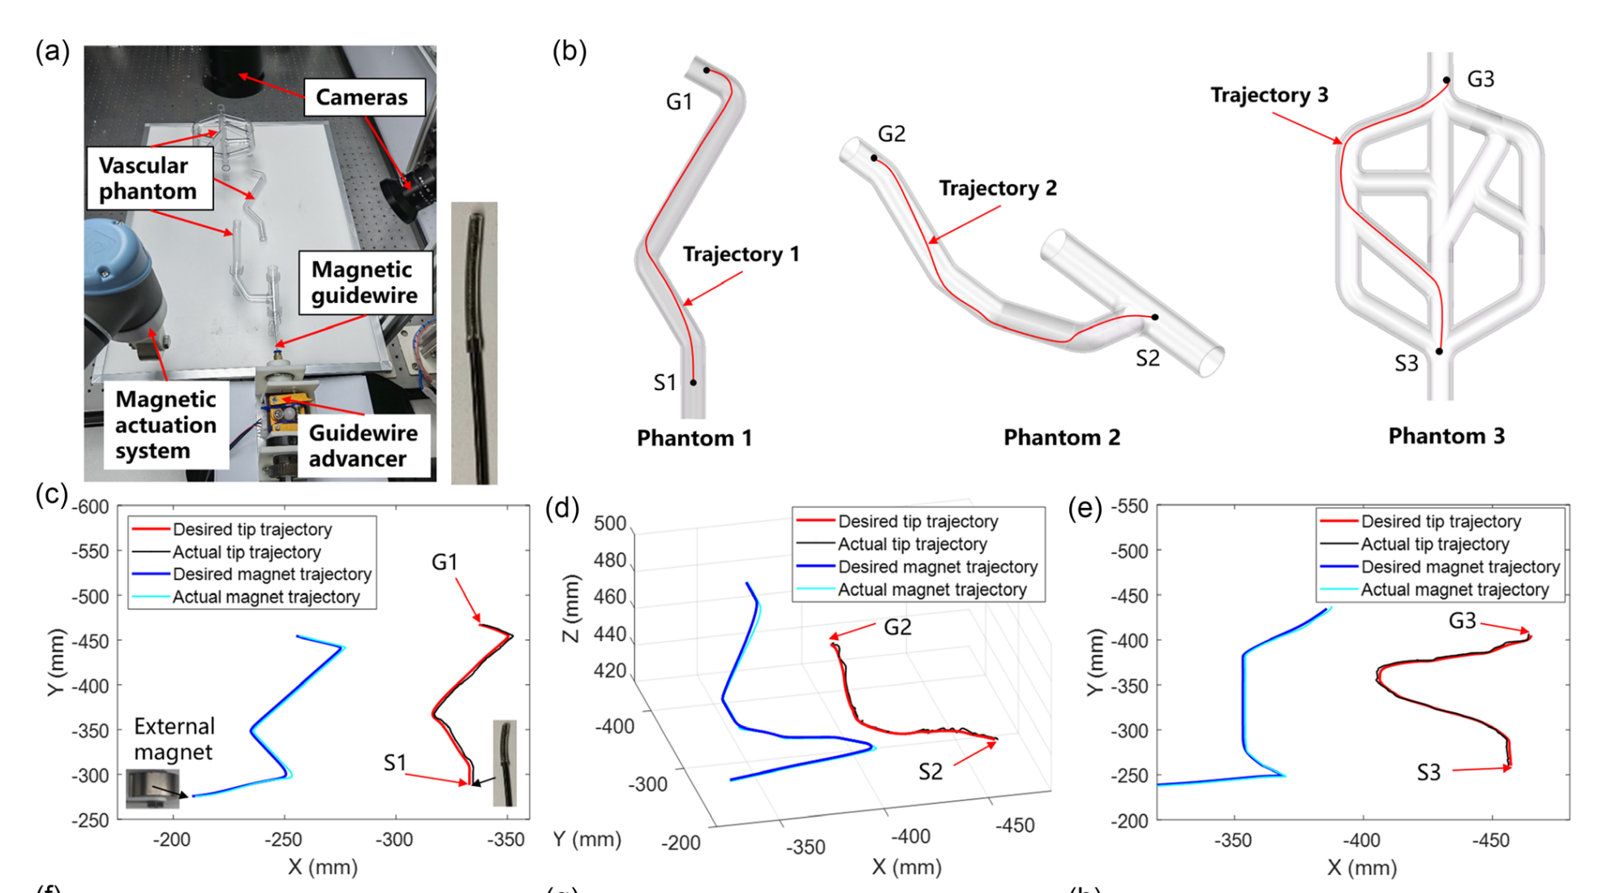
Trajectory navigation
Fu, S., Xu, T. et al. 2023

Slide 9
Target
Dynamic and Mechanics of Rods
Real-time Simulator
Deflection-Magnetic Field-Current Inverse Problem
Auto-Magnetically Controlled Guidewire Robot System

Slide 10
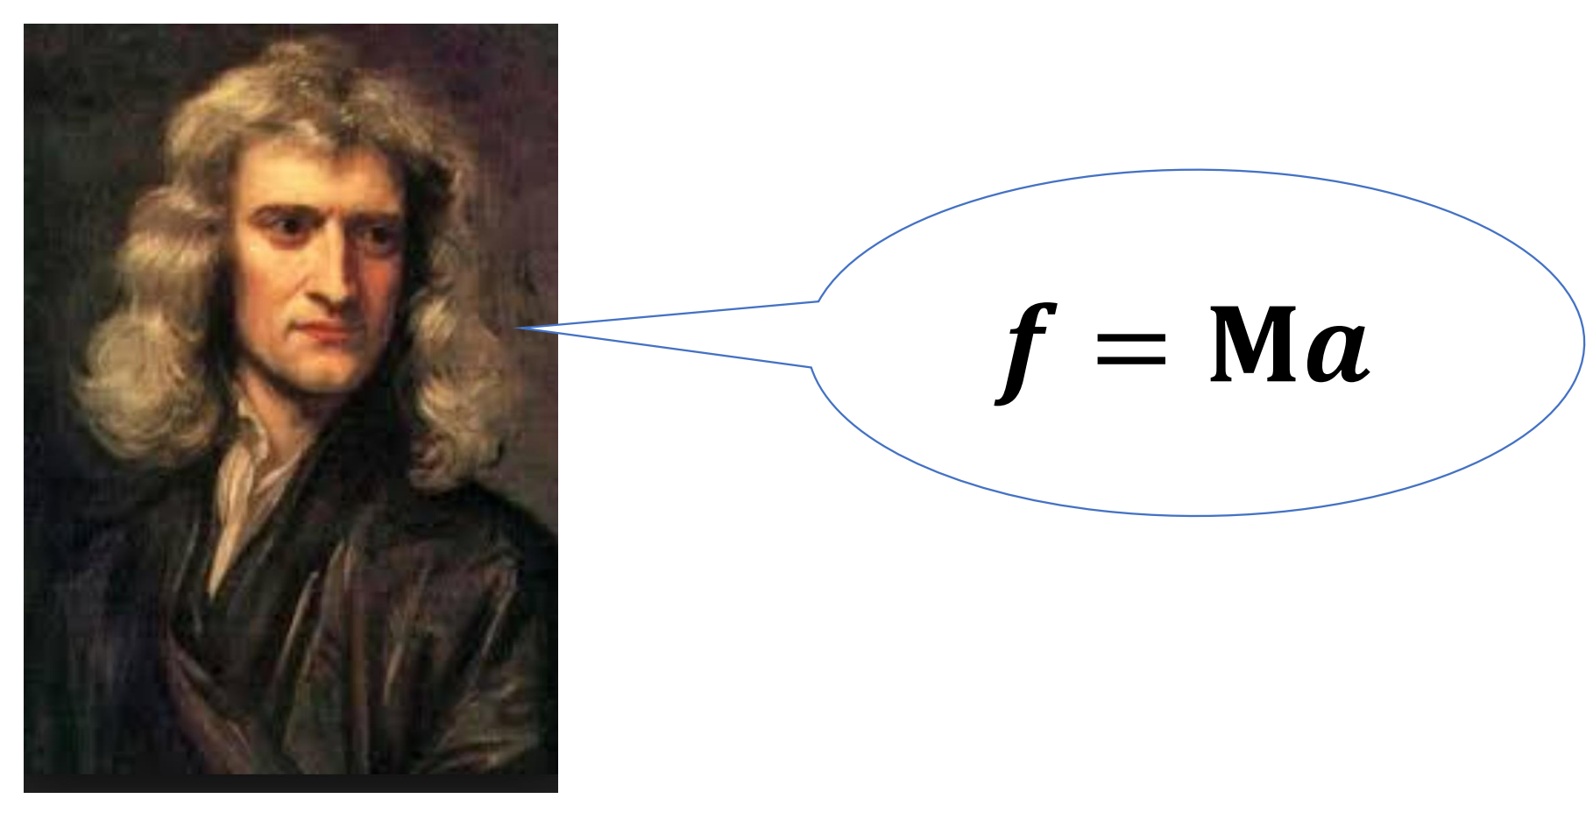
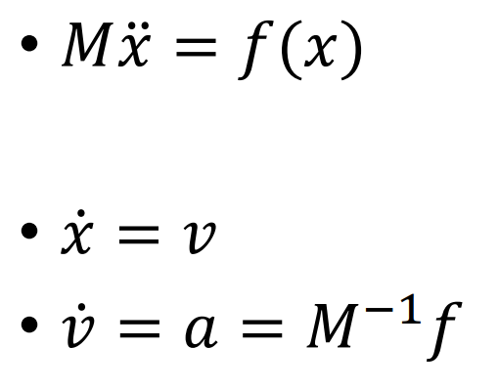
Deformable Object Simulation
Laws of physics

Slide 11
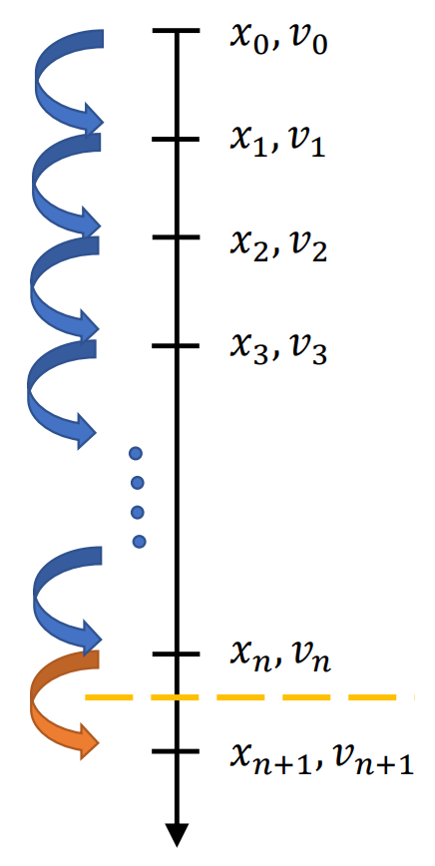
Laws of physics

Slide 12
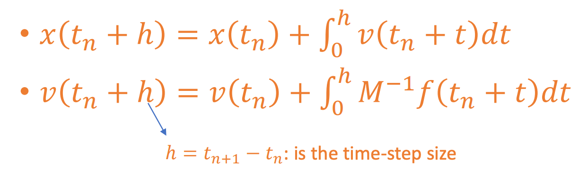
Laws of physics

Slide 13
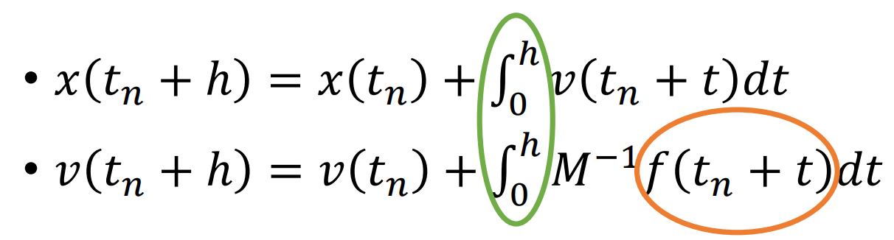
Time Integration

Slide 14
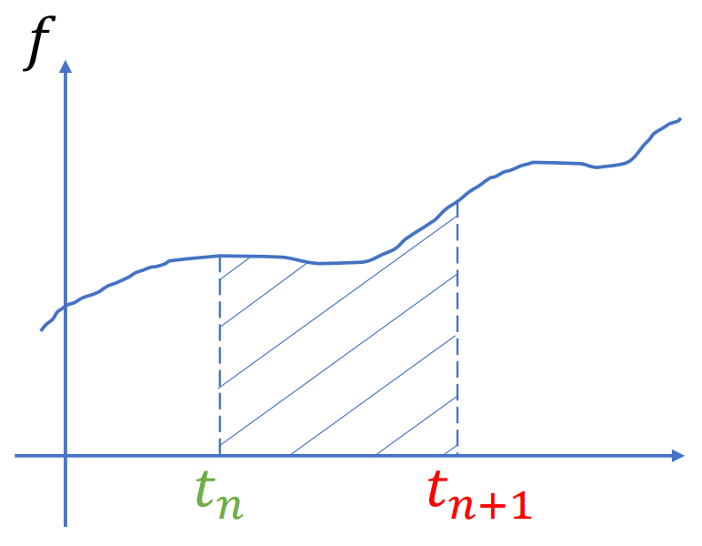
Time Integration

Slide 15
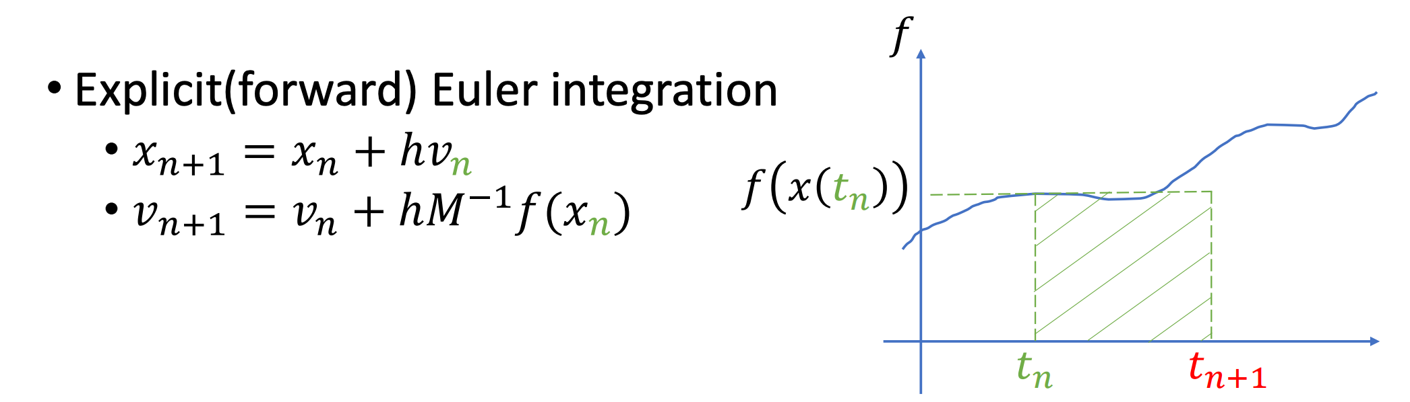
Time Integration(explicit)

Slide 16
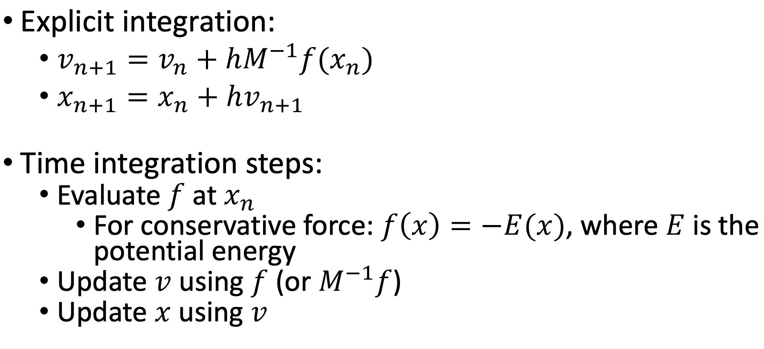

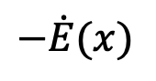
Time Integration in Practice
$$−\dot{E}(x)$$

Slide 17
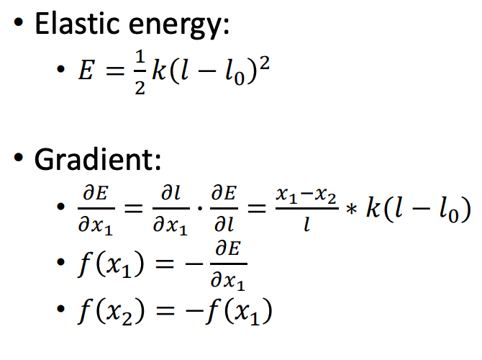
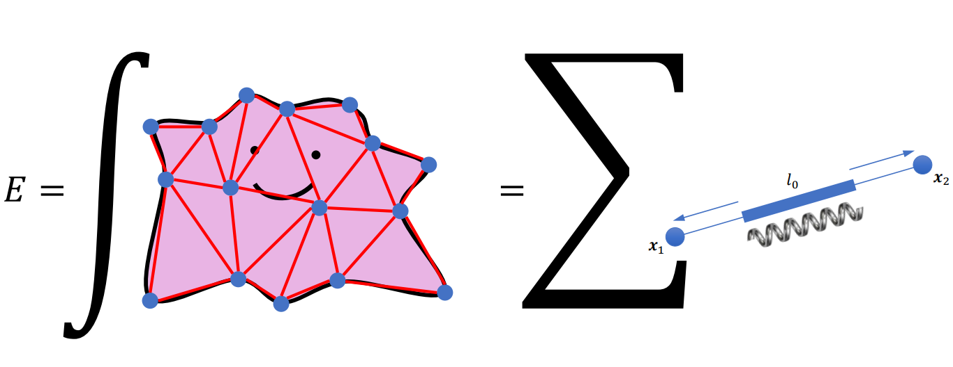
Mass-spring system

Slide 18
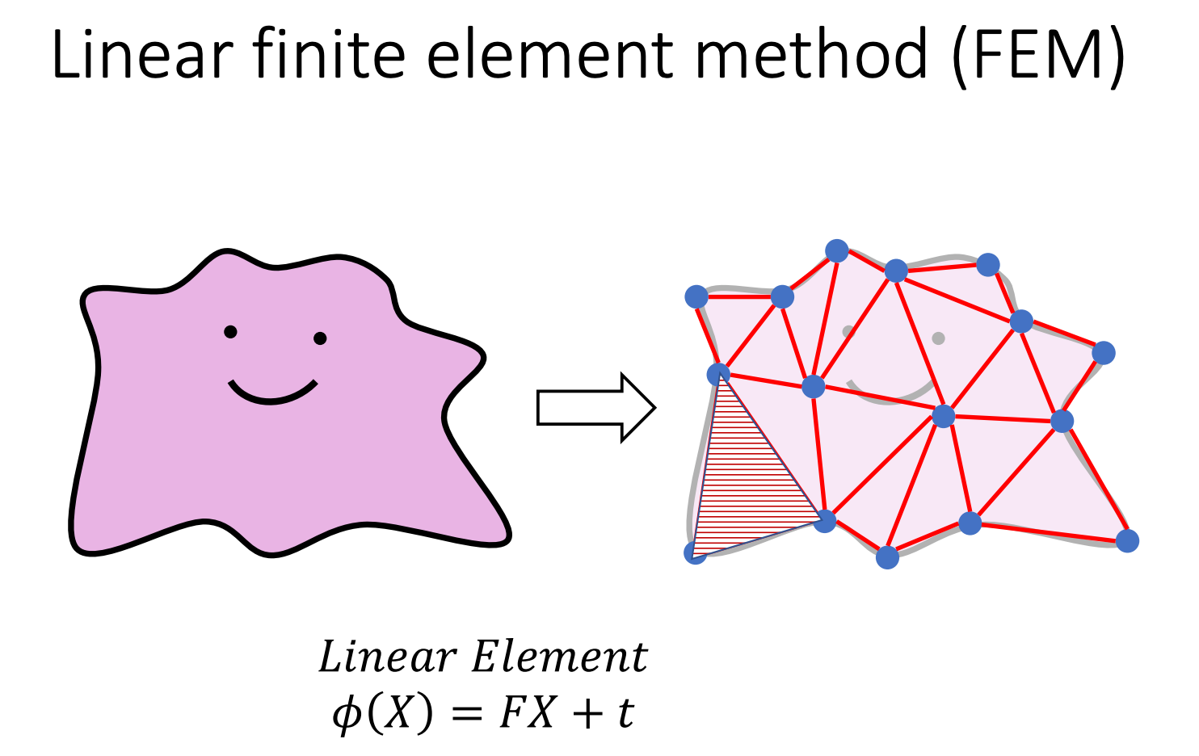

Slide 19
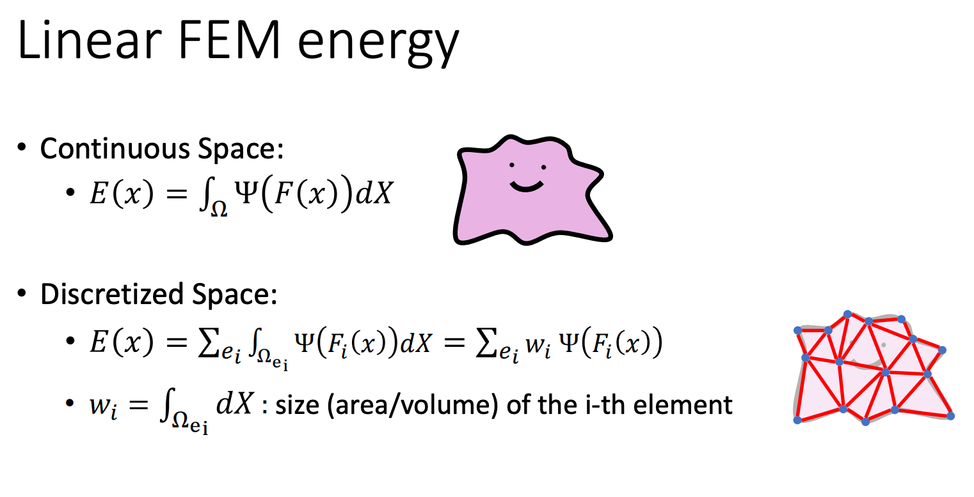

Slide 20
3D continua and 1D continua

Slide 21
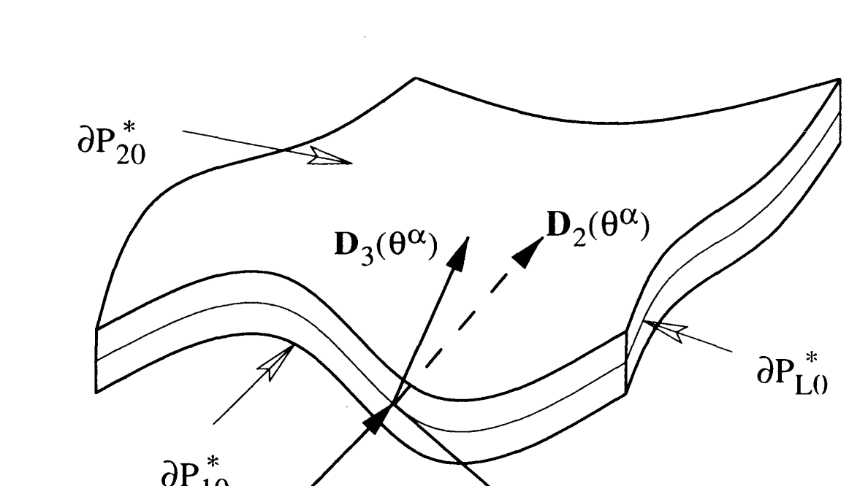
3D continua and 1D continua
M. B. Rubin, Cosserat Theories: Shells, Rods and Points

Slide 22
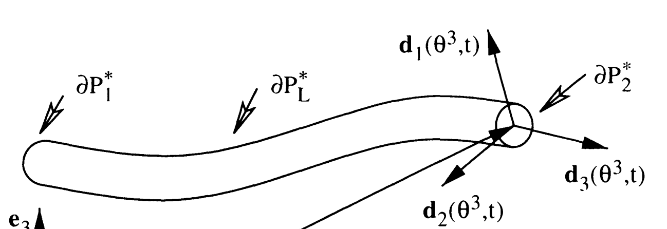
3D continua and 1D continua
M. B. Rubin, Cosserat Theories: Shells, Rods and Points

Slide 23
3D continua and 1D continua
M. B. Rubin, Cosserat Theories: Shells, Rods and Points

Slide 24
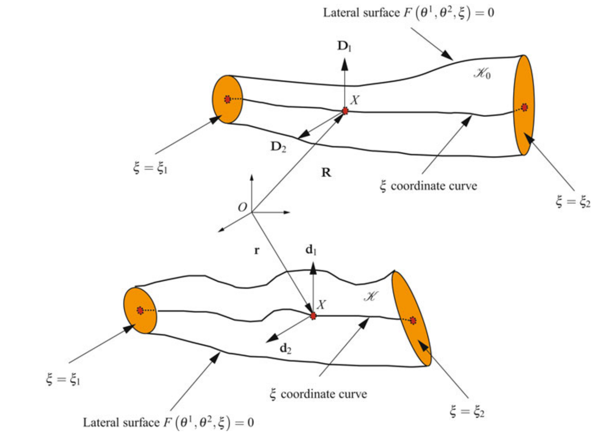
Cosserat Rod Theory
M. B. Rubin, Cosserat Theories: Shells, Rods and Points

Slide 25
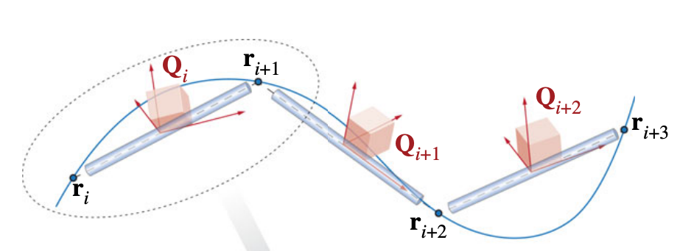
Cosserat Rod Theory
M. B. Rubin, Cosserat Theories: Shells, Rods and Points

Slide 26
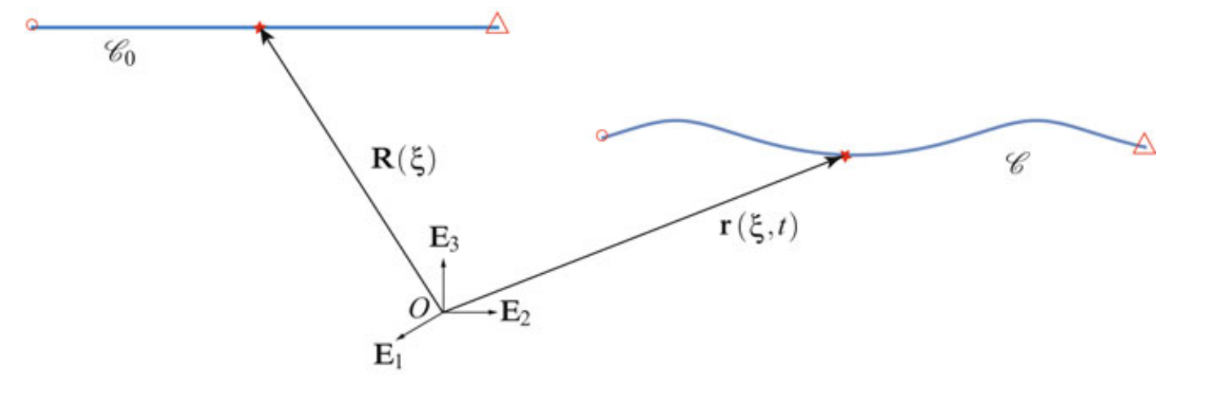
The Lagrange coordinate
M. B. Rubin, Cosserat Theories: Shells, Rods and Points

Slide 27
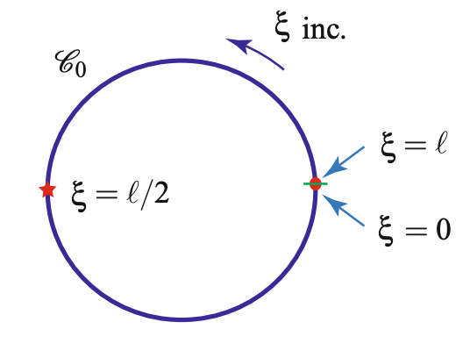
The Lagrange coordinate
M. B. Rubin, Cosserat Theories: Shells, Rods and Points

Slide 28
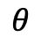
The Lagrange coordinate
$$θ$$
M. B. Rubin, Cosserat Theories: Shells, Rods and Points

Slide 29
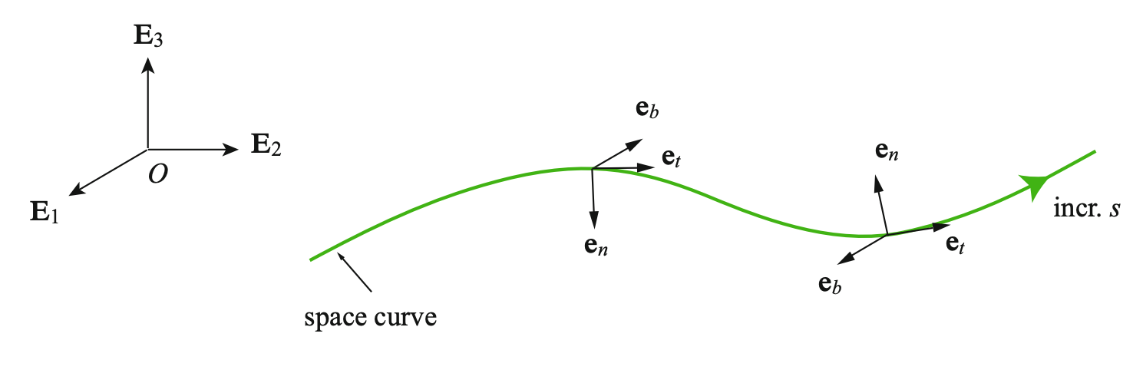
The Lagrange coordinate
M. B. Rubin, Cosserat Theories: Shells, Rods and Points

Slide 30
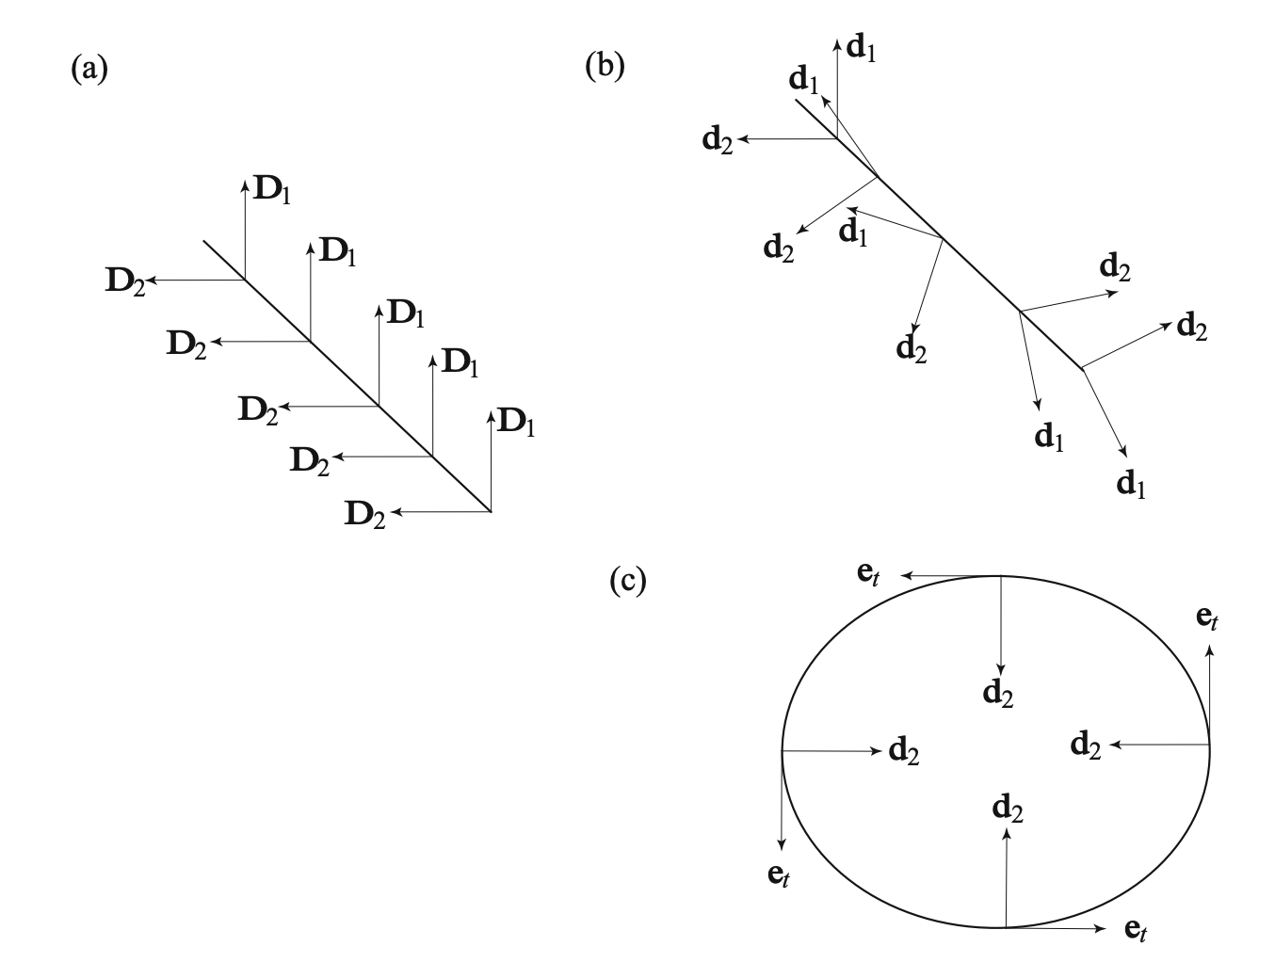
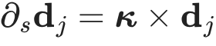
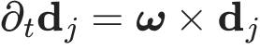
The Lagrange coordinate
M. B. Rubin, Cosserat Theories: Shells, Rods and Points

Slide 31
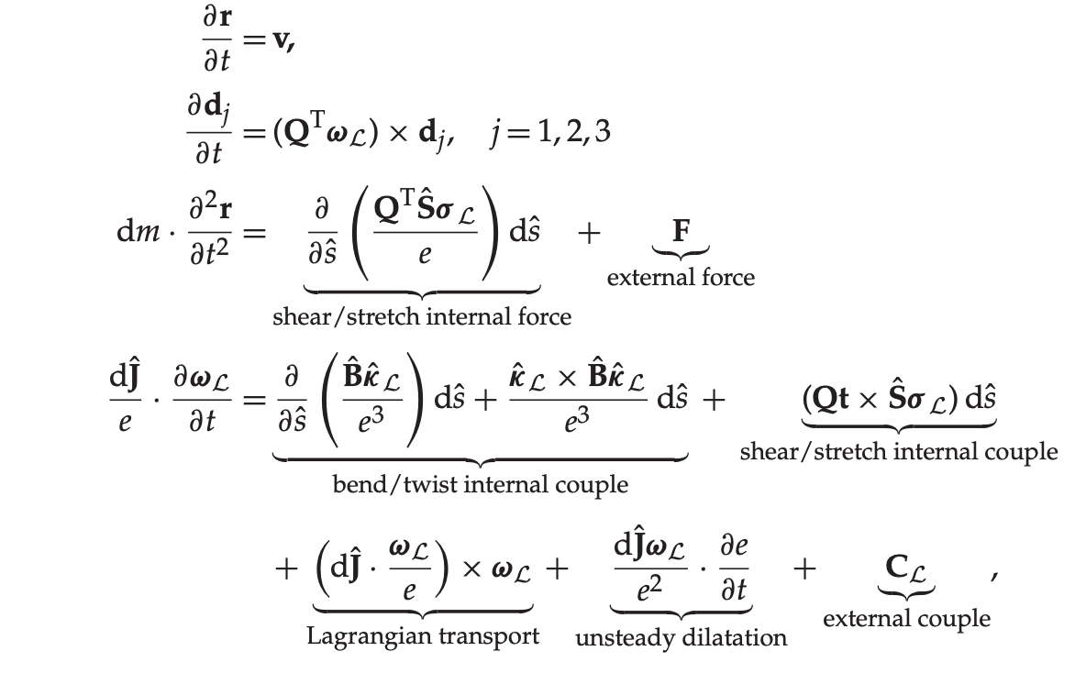
Mechanics of a Rod
M. B. Rubin, Cosserat Theories: Shells, Rods and Points

Slide 32
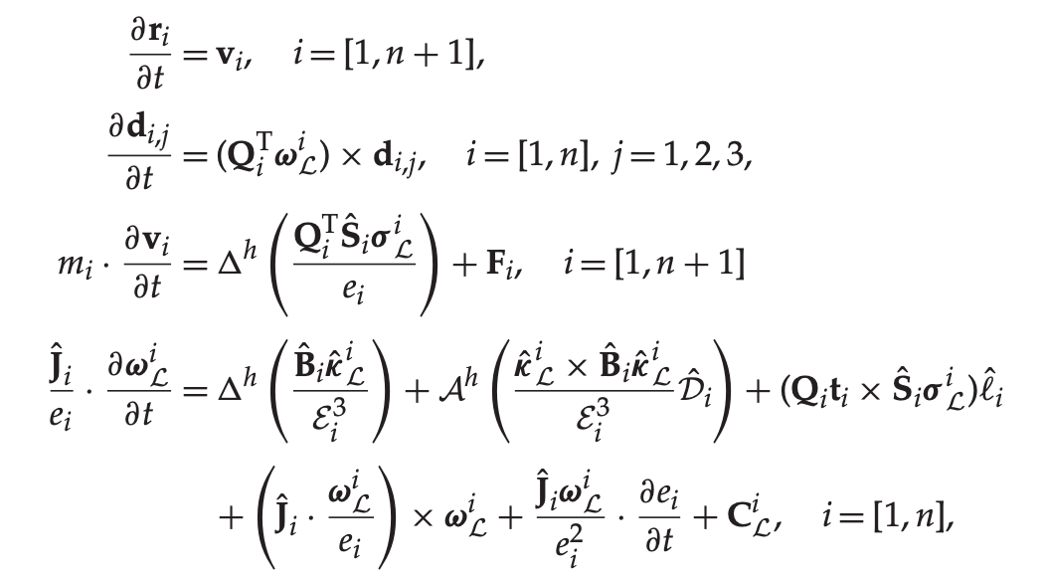
Mechanics of a Rod
M. B. Rubin, Cosserat Theories: Shells, Rods and Points

Slide 33
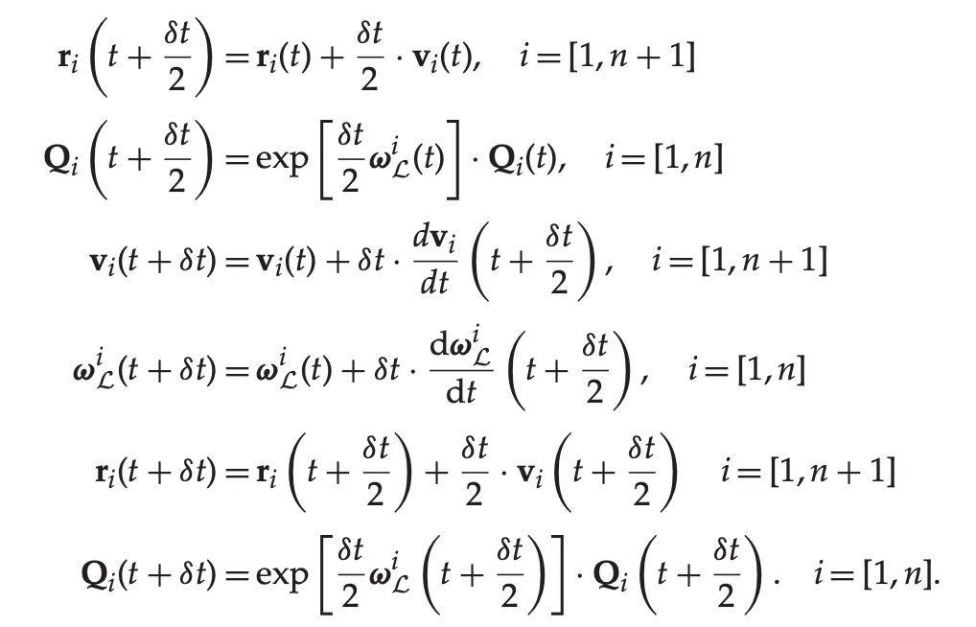
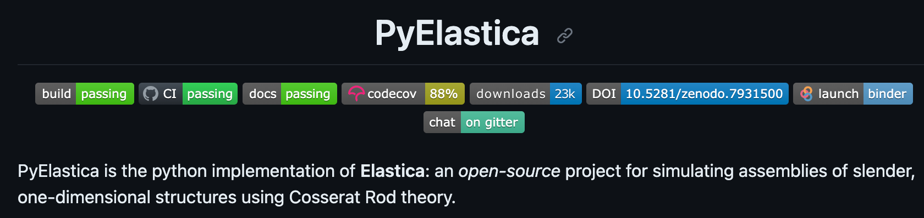
Time Integration (Symplectic, Verlet integrator)
M. B. Rubin, Cosserat Theories: Shells, Rods and Points

Slide 34
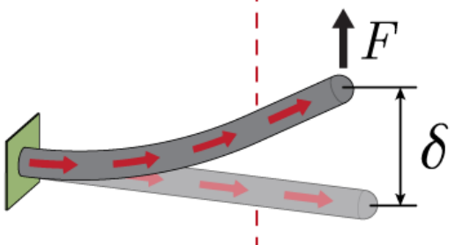
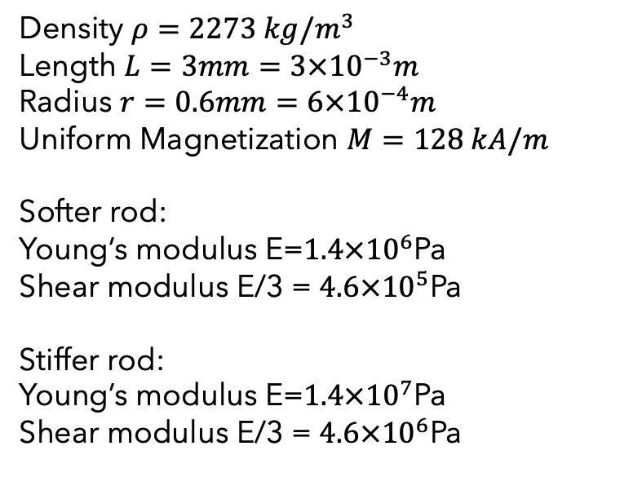
Dynamics and Mechanics of a Rod
Density $ρ=2273 kg/m^{3}$
Length $L=3mm=3×{10}^{−3}m$
Radius $r=0.6mm=6×{10}^{−4}m$
Uniform Magnetization $M=128 kA/m$
Softer rod:
Young’s modulus E=$1.4×{10}^{6}$Pa
Shear modulus E/3 = $4.6×{10}^{5}$Pa
Stiffer rod:
Young’s modulus E=$1.4×{10}^{7}$Pa
Shear modulus E/3 = $4.6×{10}^{6}$Pa
Yoonho Kimet al. 2019

Slide 35
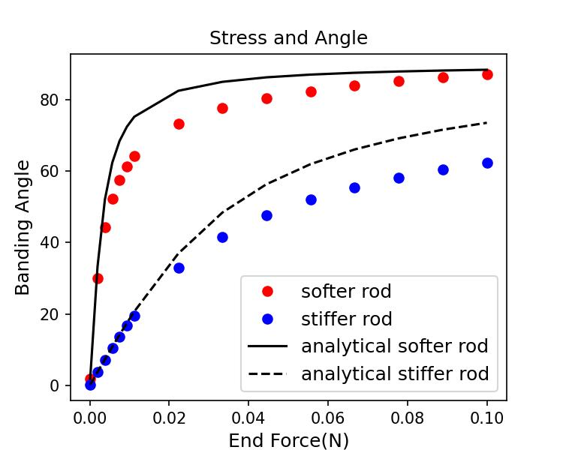
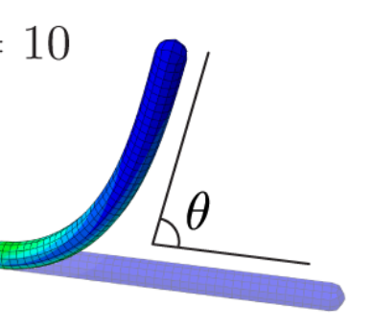
Mechanics and Dynamics of Rods
Yoonho Kimet al. 2019

Slide 36
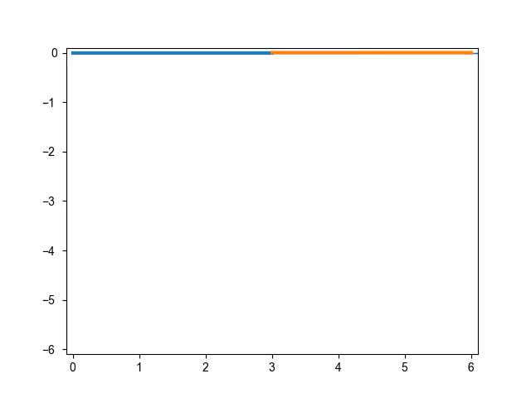
Joint Rod Simulation
F

Slide 37
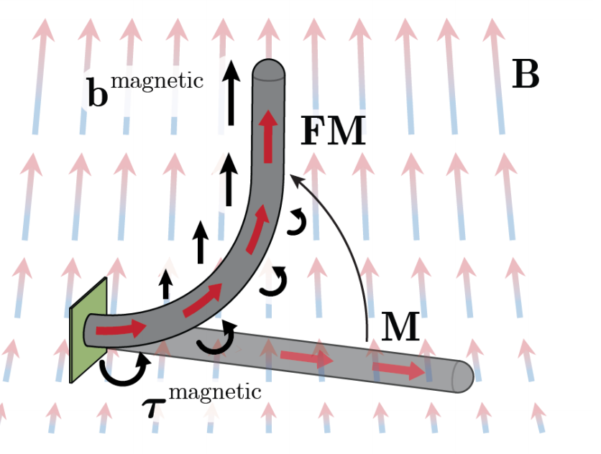
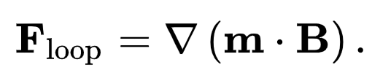
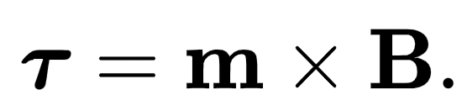
Deflection of Uniform Magnetization Rod
Yoonho Kimet al. 2019

Slide 38
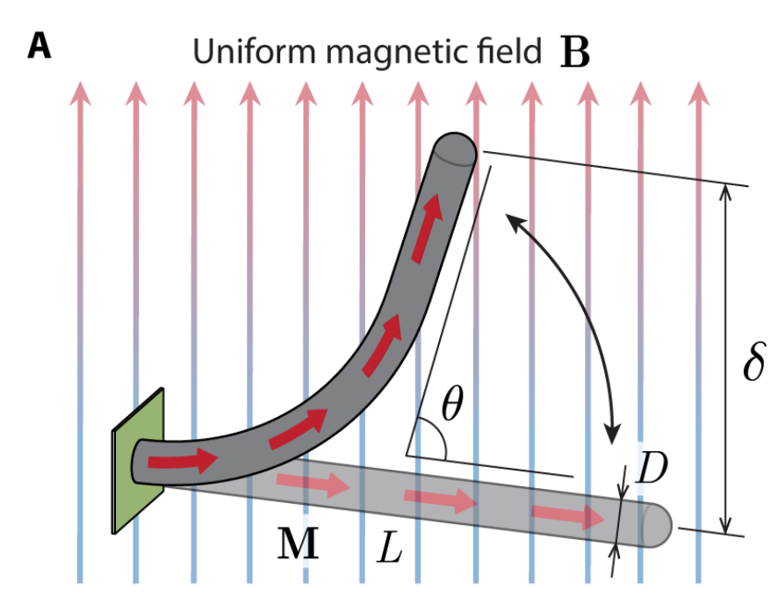
Deflection of Uniform Magnetization Rod
Yoonho Kimet al. 2019

Slide 39
Deflection of Uniform Magnetization Rod
Only torque is considered
Yoonho Kimet al. 2019

Slide 40
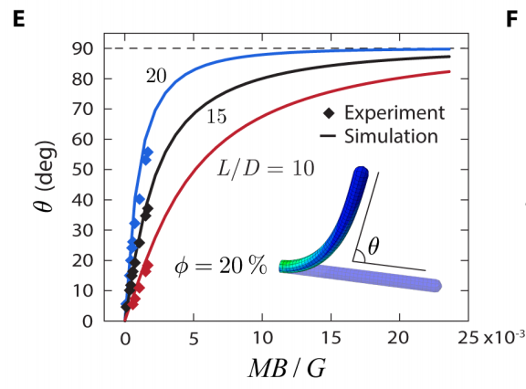
Deflection of Uniform Magnetization Rod
Only torque is considered
Yoonho Kimet al. 2019

Slide 41
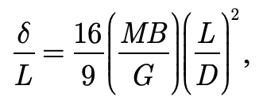
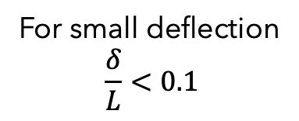
Deflection of Uniform Magnetization Rod
For small deflection
$$\frac{δ}{L}<0.1$$
Only torque is considered
Yoonho Kimet al. 2019

Slide 42
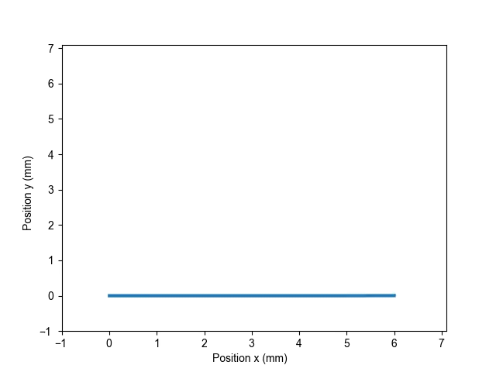
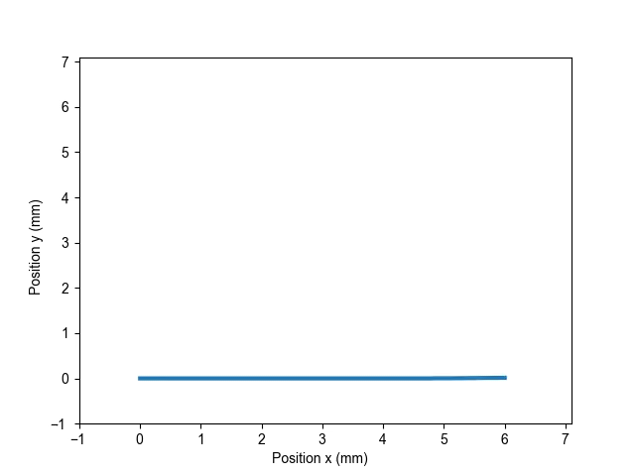
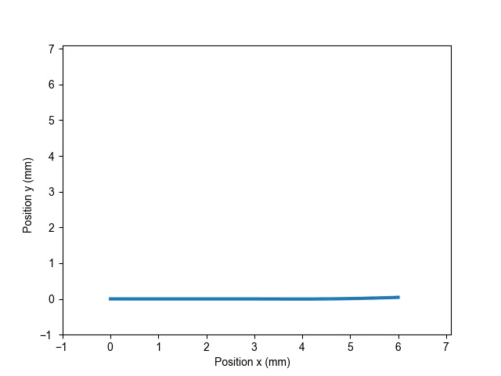
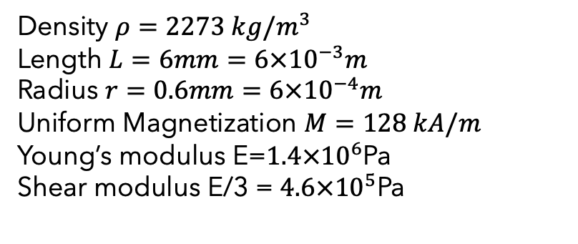
Mechanics and Dynamics of Uniform Magnetization Rods
Density $ρ=2273 kg/m^{3}$
Length $L=6mm=6×{10}^{−3}m$
Radius $r=0.6mm=6×{10}^{−4}m$
Uniform Magnetization $M=128 kA/m$
Young’s modulus E=$1.4×{10}^{6}$Pa
Shear modulus E/3 = $4.6×{10}^{5}$Pa
B = 10mT
B = 30mT
B = 90mT

Slide 43

Mechanics and Dynamics of Uniform Magnetization Rods
B = 90mT

Slide 44


Mechanics and Dynamics of Uniform Magnetization Rods
Yoonho Kimet al. 2019

Slide 45
Mechanics and Dynamics of Uniform Magnetization Rods
Yoonho Kimet al. 2019

Slide 46
Mechanics and Dynamics of Uniform Magnetization Rods

Slide 47
Remark
Project Overview
Deformable Object Simulation
Dynamics and Mechanics of a Rod (Cosserat Rod Theory)

Slide 48
Outlook
Time depending magnetic field and Real-time simulation
Robot Controlling
To Do List: non-Uniform magnetic field

Slide 49

References
Modeling Nonlinear Problems in the Mechanics of Strings and Rods by Oliver M. O’Reilly
Cosserat Theories: Shells, Rods and Points by M.B. Rubin

